Slide 1
CHEMISTRY –CLASS XII
UNIT XII-ALDEHYDES, KETONES AND CARBOXYLIC ACIDS
PART-I
[ Aldehydes and ketones: Nomenclature, preparation and physical properties ]

Slide 2
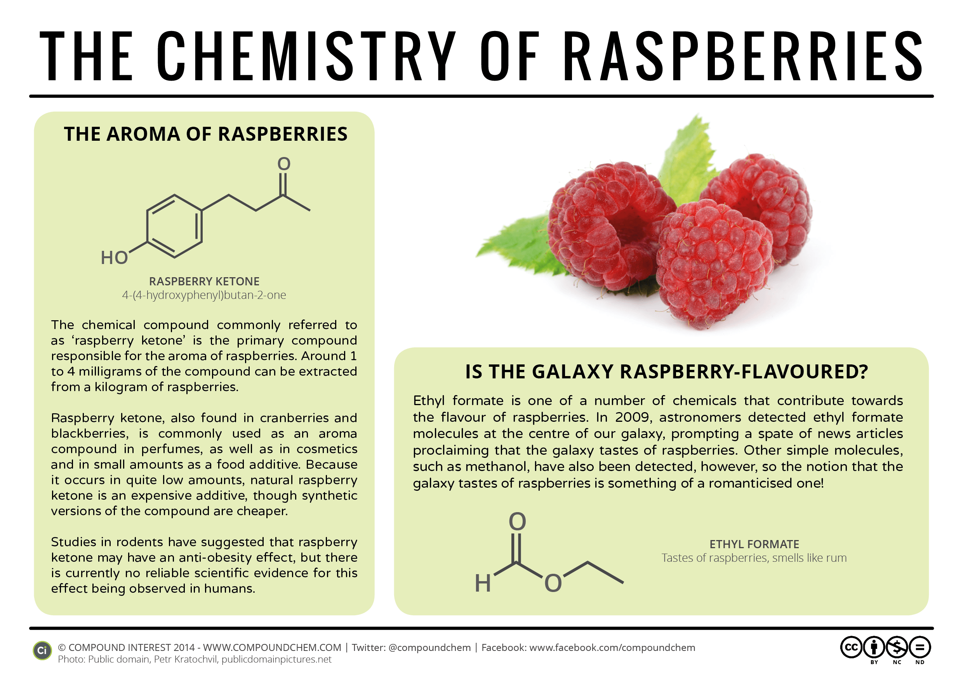
Outline
Aldehydes and ketones
Introduction
What are aldehydes and ketones?
Nomenclature of aldehydes and ketones
Structure of the carbonyl group
Common methods of preparation of aldehydes and ketones
Methods of preparation of aldehydes
Methods of preparation of ketones
Physical properties of aldehydes and ketones
R O PUNE

Slide 3
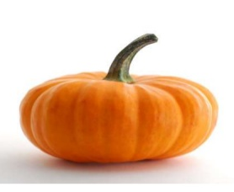
Introduction
ALDEHYDES AND KETONES
Widespread in plants and animal kingdom
They play an important role in biochemical processes of life
They add fragrance and flavour to nature
have very pleasant fragrances.
(from vanilla beans)
(from meadow sweet)
(from cinnamon)

Slide 4
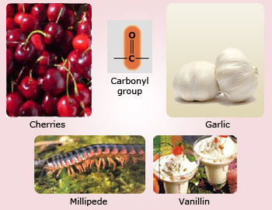
What are aldehydes and ketones?
Aldehydes and ketones are the carbonyl compounds,
which contain >C=O group
In aldehydes the carbonyl carbon is bonded to
carbon/hydrogen and hydrogen
In ketones the carbonyl carbon is bonded to
two carbon atoms.group

Slide 5

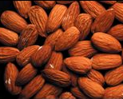
Nomenclature of aldehyde and ketones
Common names of aldehydes – derived from the common names of the corresponding carboxylic acids by replacing the ending ‘−ic’ of the acid with ‘aldehyde’

Slide 6
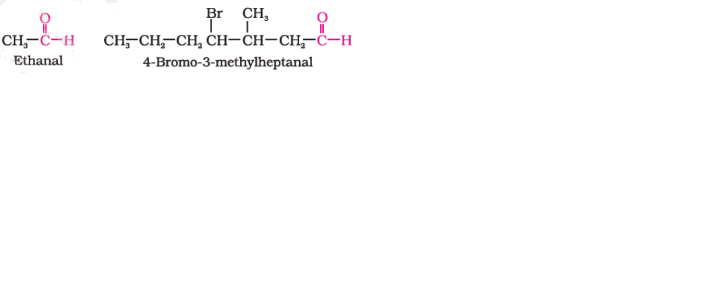
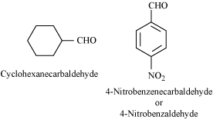
Nomenclature of aldehyde and ketones …….
IUPAC names of aldehydes are given by replacing ending ‘e’ of the corresponding alkane by suffix ‘al’
If the aldehydic group is attached to a ring, then the suffix carbaldehyde is added to the full name of cyclohexane.

Slide 7
Draw structures corresponding to the following aldehydes and ketones.
heptanal
seven carbons, saturated

Slide 8
Draw structures corresponding to the following aldehydes and ketones.
3-hydroxy-2,2,4-trimethylpentanal
five carbons, saturated aldehyde
5
3
4
2
1

Slide 9
Draw structures corresponding to the following aldehydes and ketones.
3-hydroxy-2,2,4-trimethylpentanal

Slide 10
Draw structures corresponding to the following aldehydes and ketones.
4
2
5
3
1
=
3,3-dimethyl
pentanal

Slide 11
Give systematic names for the following aldehydes and ketones.
3,3-dimethyl
pentanal

Slide 12
Nomenclature of aldehyde and ketones……..
Common names of ketones – derived by naming two alkyl or aryl group.
In case of alkyl phenyl ketones –acyl group as a prefix to phenone

Slide 13
Nomenclature of aldehyde and ketones …….
IUPAC names of ketones are given by replacing ending ‘e’ of the corresponding alkane by suffix ‘one’
R O PUNE

Slide 14
Draw structures corresponding to the following aldehydes and ketones.
2,4-dimethyl-3-pentanone
five carbons, saturated ketone
4
2
5
3
1

Slide 15
Structure of the carbonyl group
Sp2 hybridized carbonyl carbon-Tringular coplanar
>C=O bond is polarized due to higher electronegativity of oxygen tnan carbon
R O PUNE

Slide 16
Common methods of preparation of aldehydes and ketones
1.By oxidation of alcohols
2.By dehydrogenation of alcohols
3. From Hydrocarbons
A) By ozonolysis of alkenes
B) By hydration of alkynes
R O PUNE

Slide 17
Common methods of preparation of aldehydes and ketones…..
1.By oxidation of alcohols
R O PUNE

Slide 18
Common methods of preparation of aldehydes and ketones…..
2.By dehydrogenation of alcohols
Tertiary alcohols do not undergo dehydrogenation
R O PUNE

Slide 19
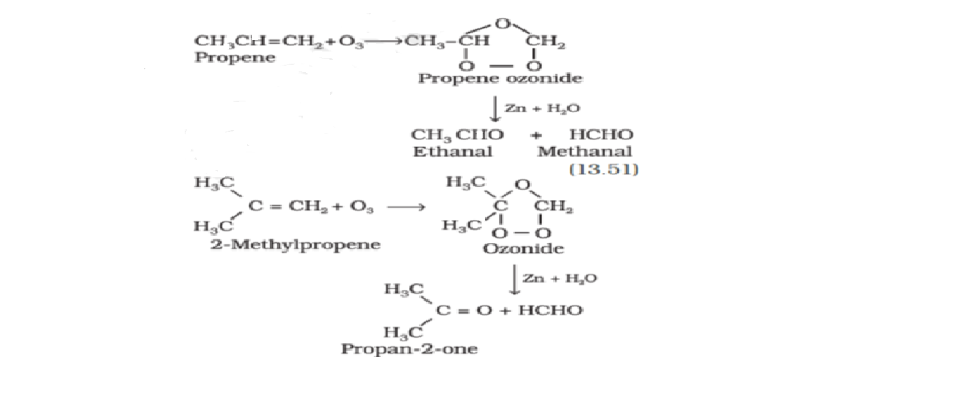
Common methods of preparation of aldehydes and ketones…..
3. From Hydrocarbons
By ozonolysis of
alkenes
R O PUNE

Slide 20
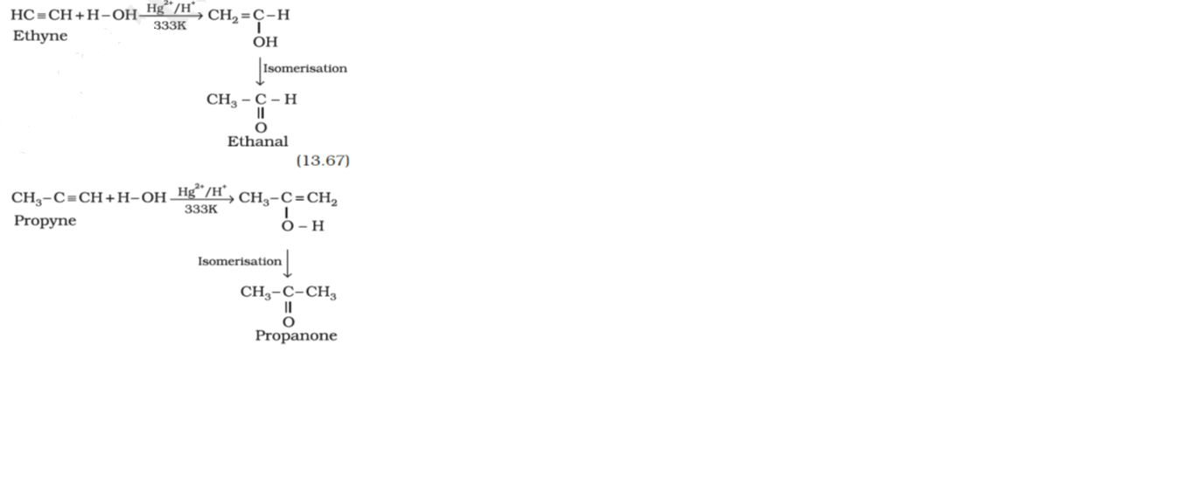
Common methods of preparation of aldehydes and ketones…..
3. From Hydrocarbons
B) By Hydration of
alkenes
R O PUNE

Slide 21
Methods of preparation of aldehydes
1. From Acid chlorides (Rosenmund reduction )
2. From nitriles and esters
3. From Hydrocarbons
[ Methylbenzene ]
[ Benzene ] (Gatterman-Koch reaction)
R O PUNE

Slide 22
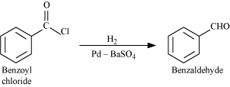
Methods of preparation of aldehydes…….
1. From Acid chlorides ( Rosenmund reduction )
R O PUNE

Slide 23
Methods of preparation of aldehydes……
2. From nitriles and esters
This reaction is called Stephen reaction
AlH(i-Bu)2 DIBAL-H Di isobutyl aluminium hydride
R O PUNE

Slide 24
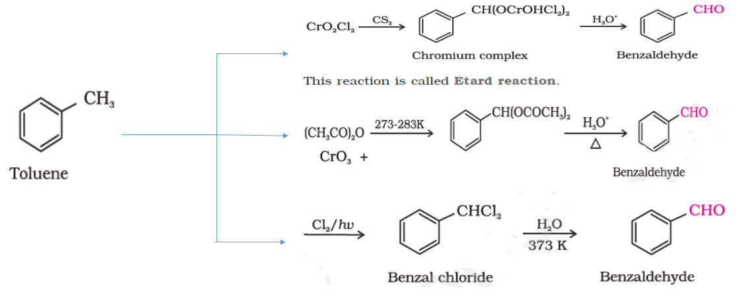
Methods of preparation of aldehydes……
thods of preparation of aldehydes……
3. From Hydrocarbons [ Methylbenzene ]
R O PUNE

Slide 25
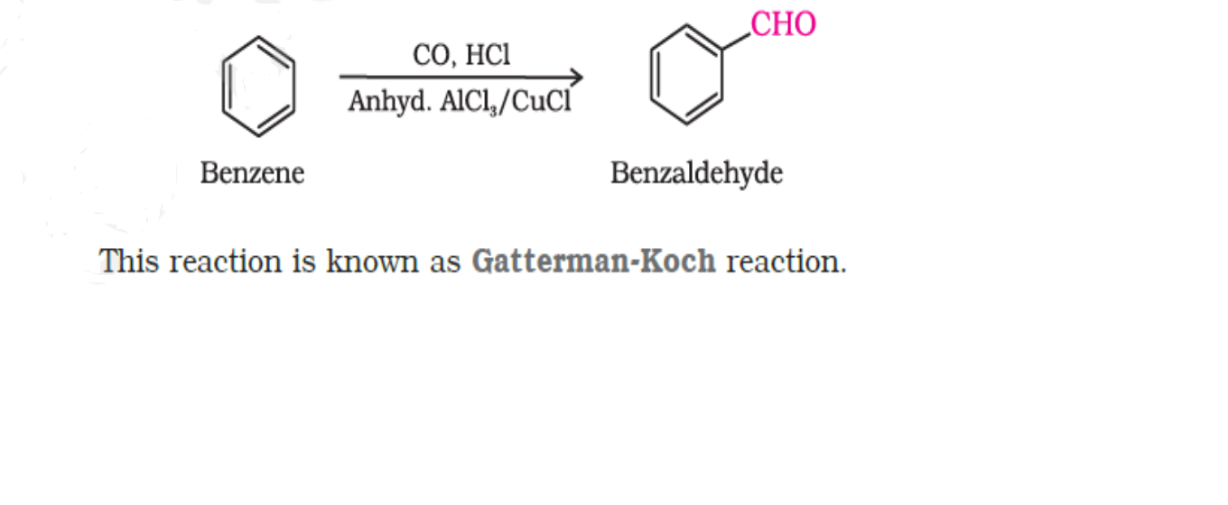
Methods of preparation of aldehydes……
3. From Hydrocarbons [ Benzene ]
Gatterman- Koch reaction
R O PUNE

Slide 26
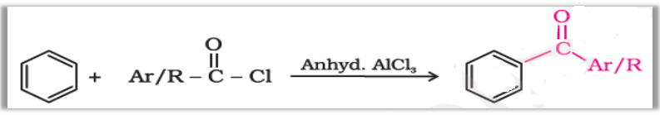
Methods of preparation of ketones……
1. From Acid
chlorides
2. From Nitriles
3. From benzene
or substituted
benzene
This is Friedel-Crafts acylation reaction
R O PUNE

Slide 27
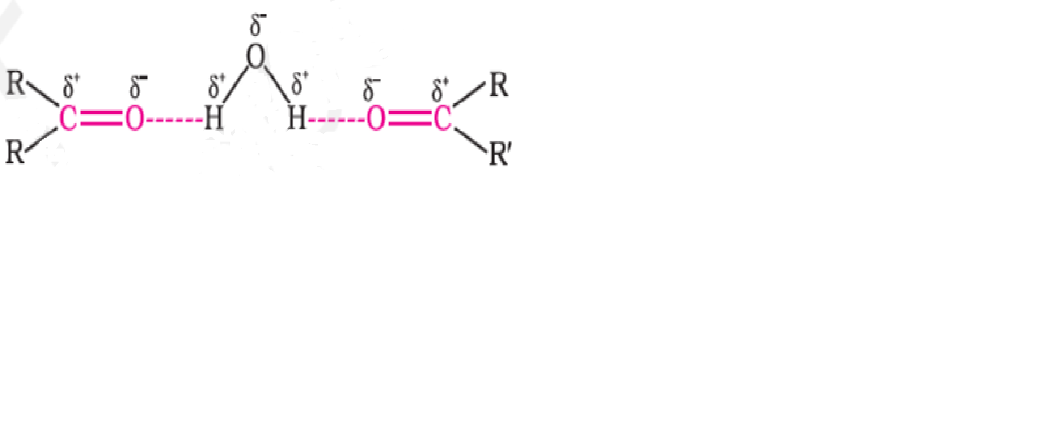
Physical properties of aldehydes and ketones
Boling points: aldehydes and ketones > hydrocarbons and ethers
Reason: weak molecular association in aldehydes and ketones,
arising out of the dipole−dipole interactions
Boling points: aldehydes and ketones < alcohols
Reason: absence of intermolecular hydrogen bonding
Solubility: Lower members are soluble in water
Reason: form intermolecular hydrogen bonds with water
R O PUNE

Slide 28
Summary
In this session we have discussed the basic concepts from the present unit such as
structures and names of aldehydes and ketones
important preparation methods of aldehydes and ketones including the name rections such as Rosenmund reduction Etard reaction Stephen reaction Gatterman –Koch reaction etc.
Also we have covered the comparative study of the physical properties of aldehydes and ketones
R O PUNE

Slide 29
Thank you

